Slide 1
BI Mini Project Cricket DATA analysis
Compiled By
Tanvi Gupta
ID: 3000120

Slide 2
ABSTRACT
Data for all players of ODI, T20 and Test conveys important information such as matches played, runs scored, batting innings etc.
The purpose of this project is to analyze the performance of players considering various parameters.
It uses parameters such as batting average, bowling average, runs scored to find the top and bottom players.

Slide 3
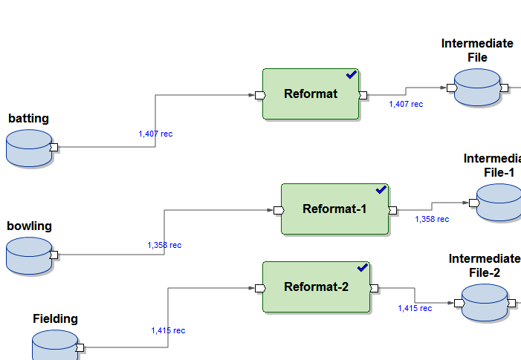
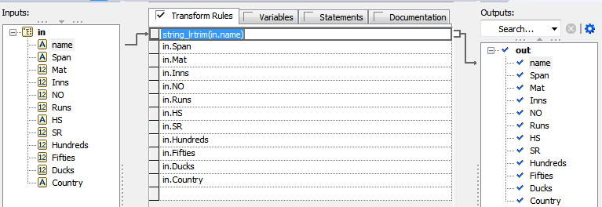
Data Cleaning

Slide 4
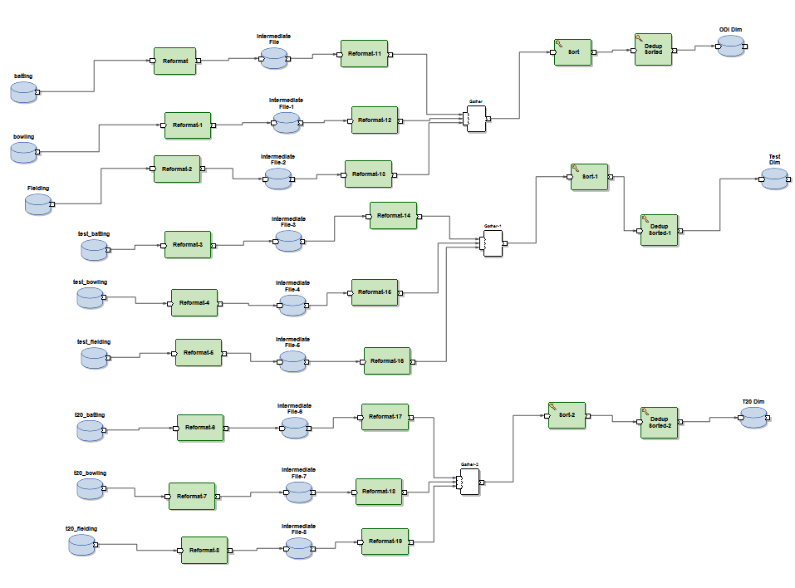
DIMENSION TABLES

Slide 5
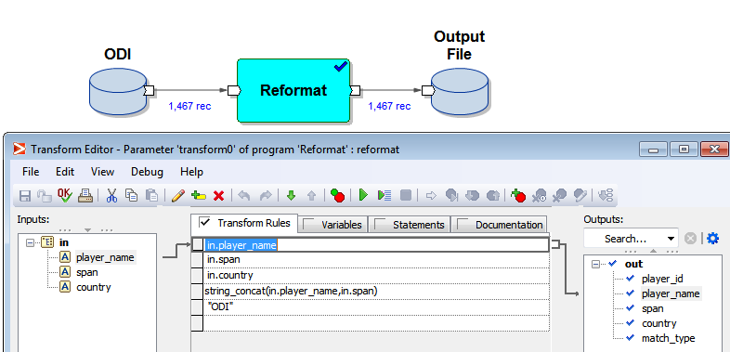
DATA TRANSFORMATIONS TO GENERATE PLAYER ID

Slide 6
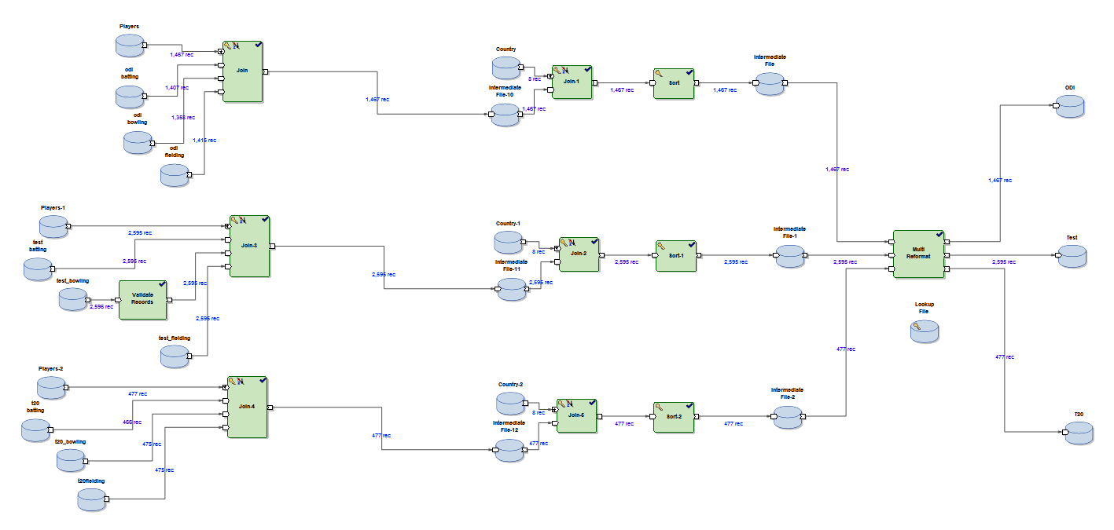
FACT Tables

Slide 7
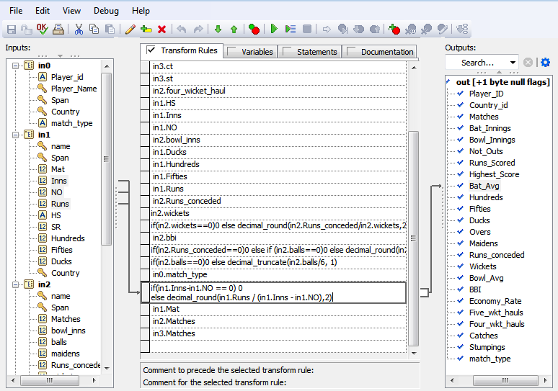

FORMULAS USED IN FACT TABLES
Formula to calculate bowling average
Formula to calculate Economy Rate

Slide 8
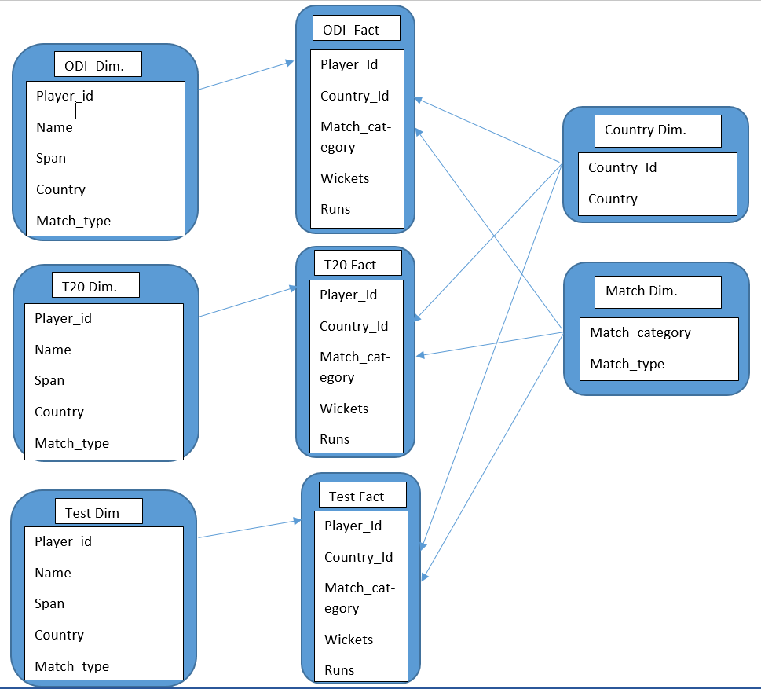
SCHEMA DIAGRAM

Slide 9
SAMPLE REPORTS
Top ten best Batting All-rounders (batting avg - desc)- All countries
Top ten best Bowling All-rounders (balling avg - asc)- All countries
Top ten best batsmen in terms of runs scored - All countries
Top three best batsmen in terms of runs scored – Countrywise
Top ten best Ballers in terms of Wickets – All Countries
Top three best ballers in terms of wickets – Countrywise
Bottom Five Batsmen(Consider lowest Batting Average) – All countries
Bottom Five Ballers(Consider Highest Bowling Average) – All Countries
Best Player in Terms of Highest Runs – All Countries and CountryWise
Best Player in terms of Most Runs – All Countries and CountryWise
Best Player in terms of Most wickets – All Countries and CountryWise
Most Innings - All Countries and CountryWise
Maximum Number of Hundreds in Test, ODI and t20 format – All Countries and CountryWise
Maximum number of 50’s in Test, ODI and t20 format – All Countries and CountryWise
Maximum number of Not Out’s in Test. – All Countries and CountryWise

Slide 10
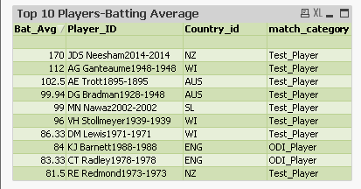
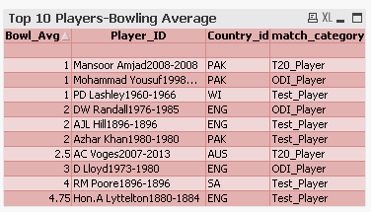
REPORTS
Top 10 Batsmen in terms of Batting Average
Top 10 Bowlers in terms of Bowling Average

Slide 11
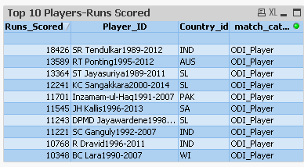
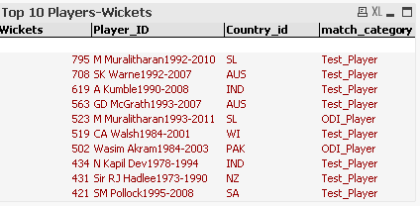
Reports
Top 10 Batsmen in terms of Runs Scored
Top 10 Players in terms of Wickets Taken

Slide 12
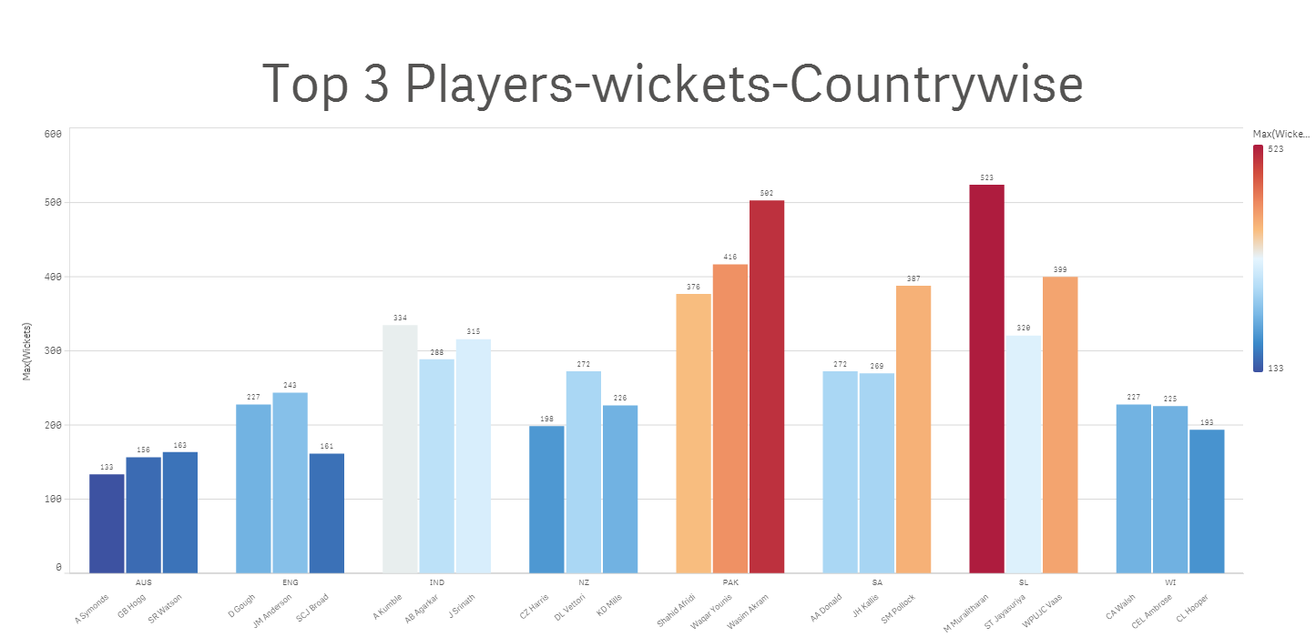
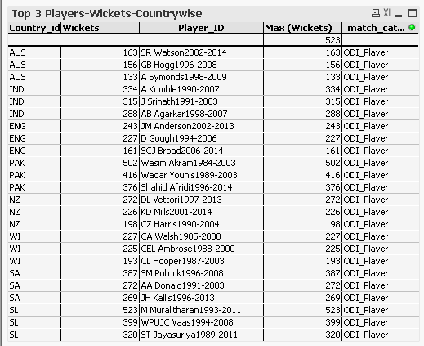
REPORTS

Slide 13
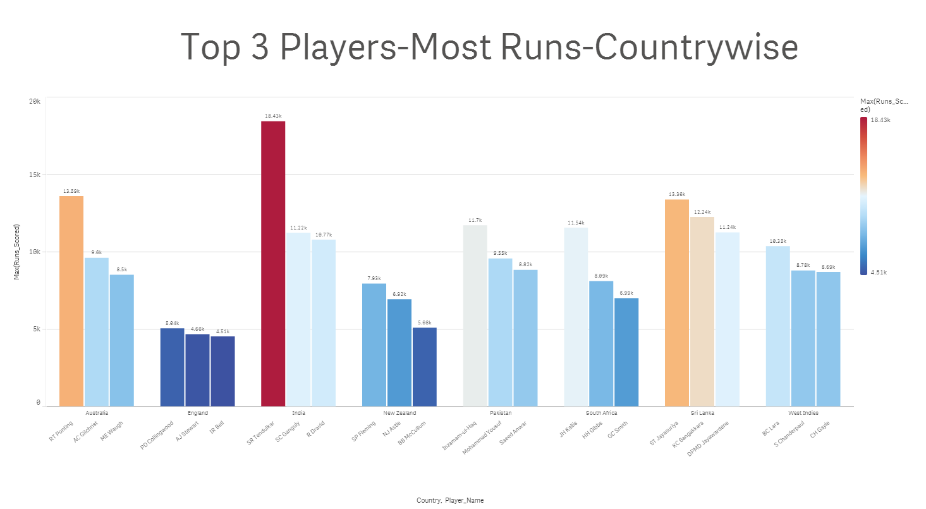
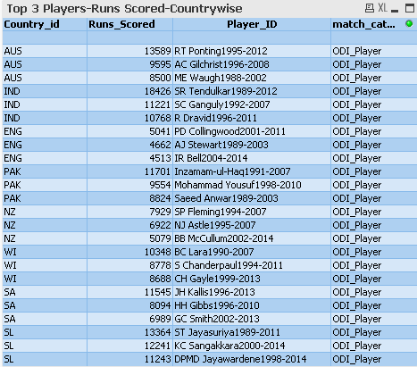
Reports

Slide 14
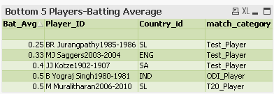
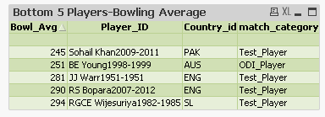
Reports
Bottom 5 Batsmen in terms of Batting Average
Bottom 5 Bowlers in terms of Bowling Average

Slide 15
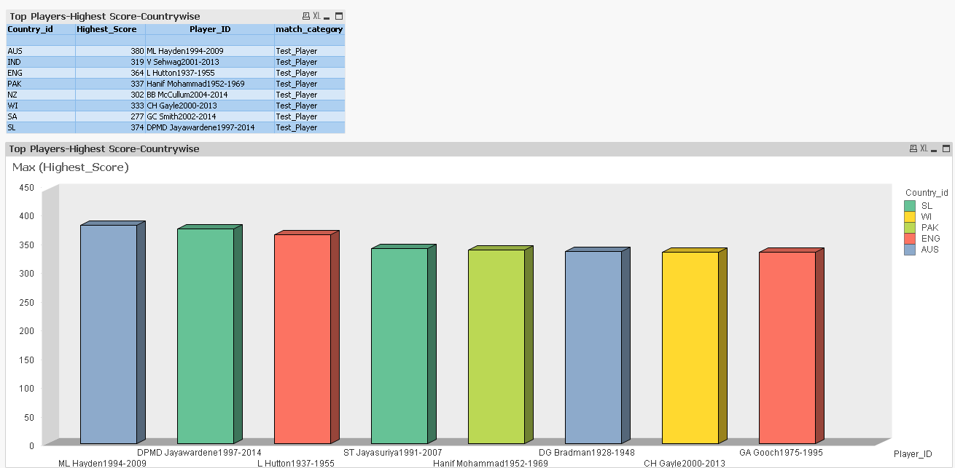
REPORTS
Best Player in terms of Highest Runs-Countrywise

Slide 16
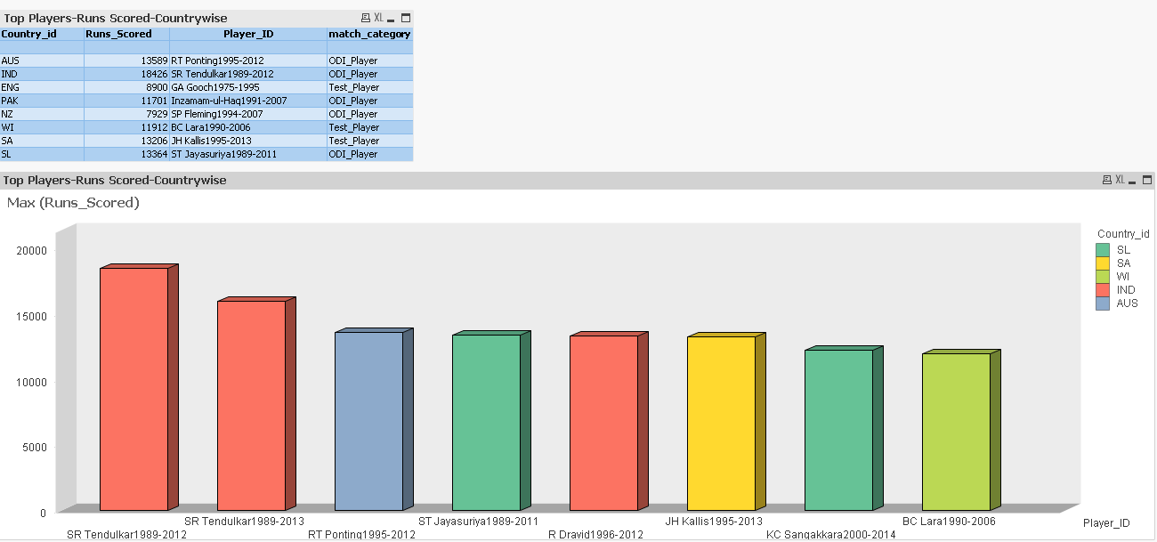
REPORTS
Best Player in terms of Runs Scored-Countrywise

Slide 17
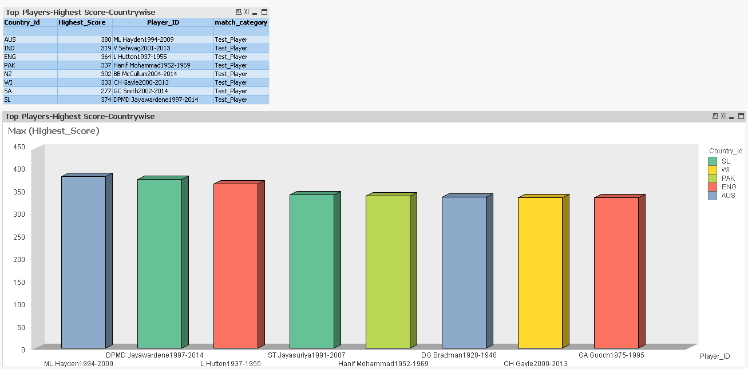
REPORTS
Best Player in terms of Wickets Taken-Countrywise

Slide 18
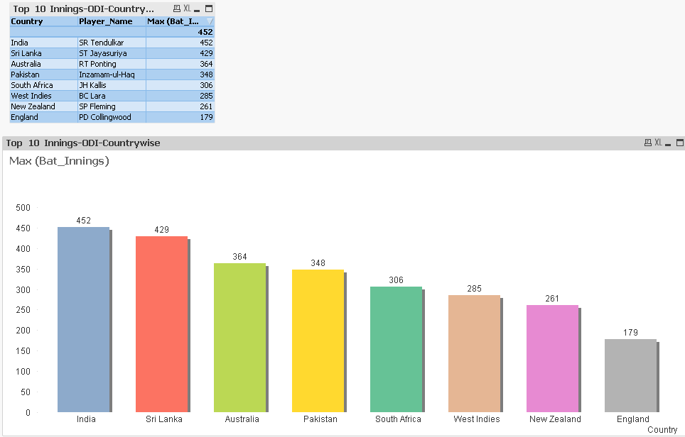
REPORTS
Best Player in terms of most Batting Innings-Countrywise

Slide 19
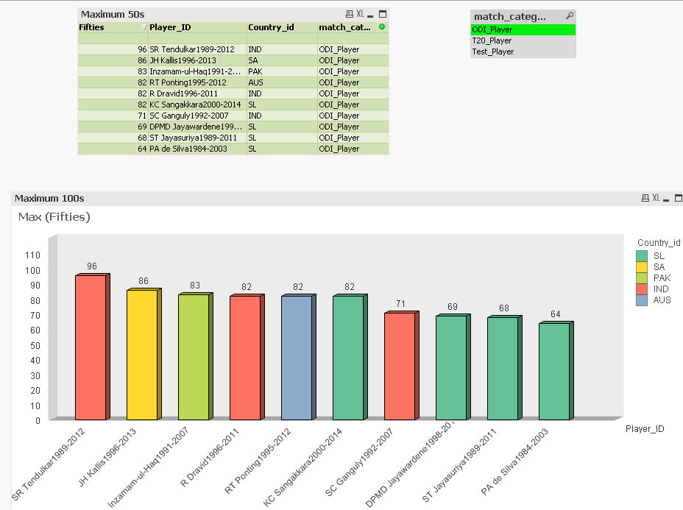
REPORTS
Best Players in terms of maximum 50s-ODI

Slide 20
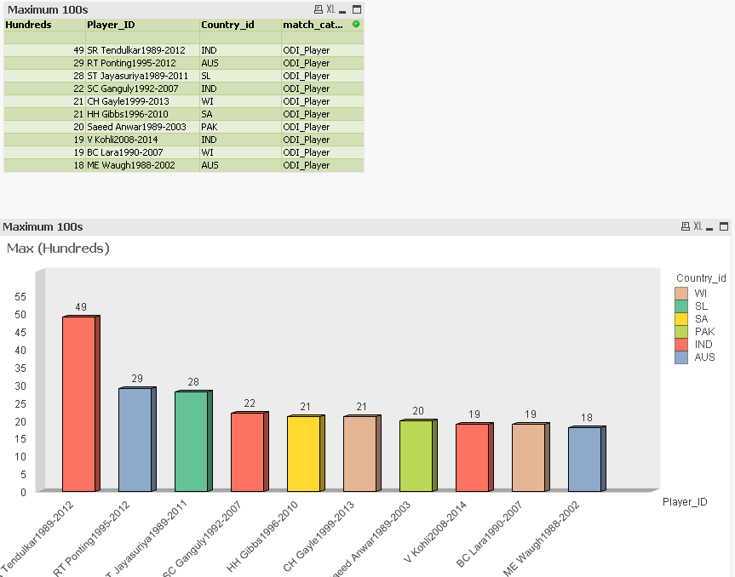
REPORTS
Best Players in terms of maximum 100s-ODI

Slide 21
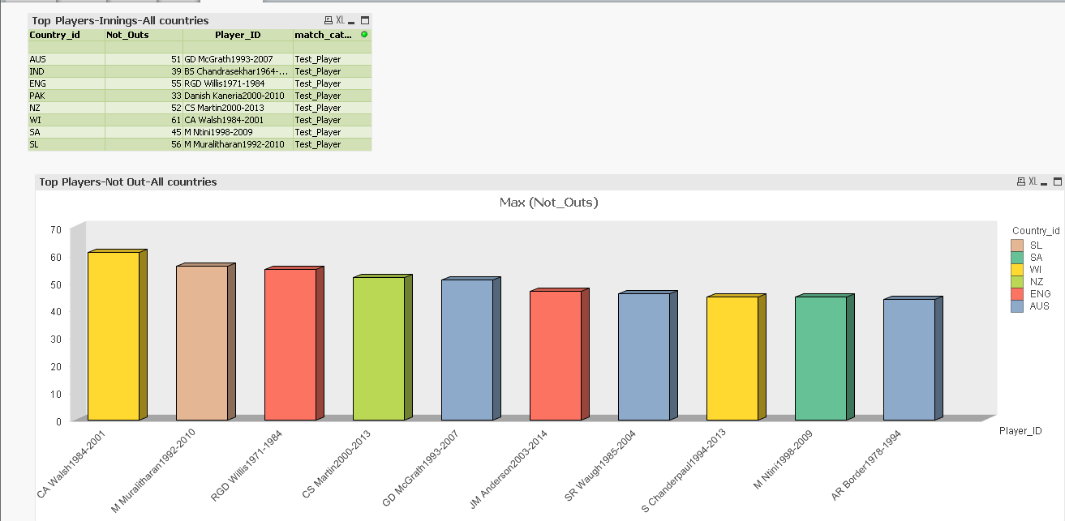
REPORTS
Best Players in terms of maximum Not Outs-ODI

Slide 22
THANK YOU…..

